Slide 1
Model notes

Slide 2
Hydrological model
2D/3D numerical model based on a lumped-parameter model approach, using
Exact location of the discharge
Representation of the flow path (i.e. sloping strata, roadways, shafts)
Include boundary conditions (i.e. lateral + source/sink terms)
Hydraulic parameters for each system feature (i.e. ‘ponds’)
Turbulent flow using pipe network model for larger flow pathways superimposed to aquifer (i.e. VSS) model to model interactions between aquifer (intact strata) and conduits in mined out areas.
Inputs:
Precipitation/evaporation/transpiration
Spring discharge / well abstraction
Stream-aquifer interaction
Inflow from deeper aquifers / marine inflow / inflow from lateral ponds
Ouputs:
Water balance (= recharge rate) and water level time-series
Timing / volumetric flux of the surface discharge

Slide 3
Hydrological model
Data:
Groudwater levels
Pumping rates
Recharge rates
Seam elevation and location of outcrops
Strata type and thickness
Location of workings / major roadways
Boundary conditions (i.e. fixed head / flow)
For aquifer model:
Porosity
Specific yield / storage
Hydraulic conductivity
Unsaturated zone parameters
For pipe network:
Pipe length, diameter, roughness
Node elevation
Location and elevation of fixed heads
Recharge rate : R=[P-ET-S]-SMDt

Slide 4
Required data
Flooding data (water level TS / flow rates)
Pumping / abstraction rates

Slide 5
Statistical analysis
Cross correlate temperature at each site (sort out by measurement type) with
Geology
Proximity of fault / dyke / granite
Reharge rate

Slide 6
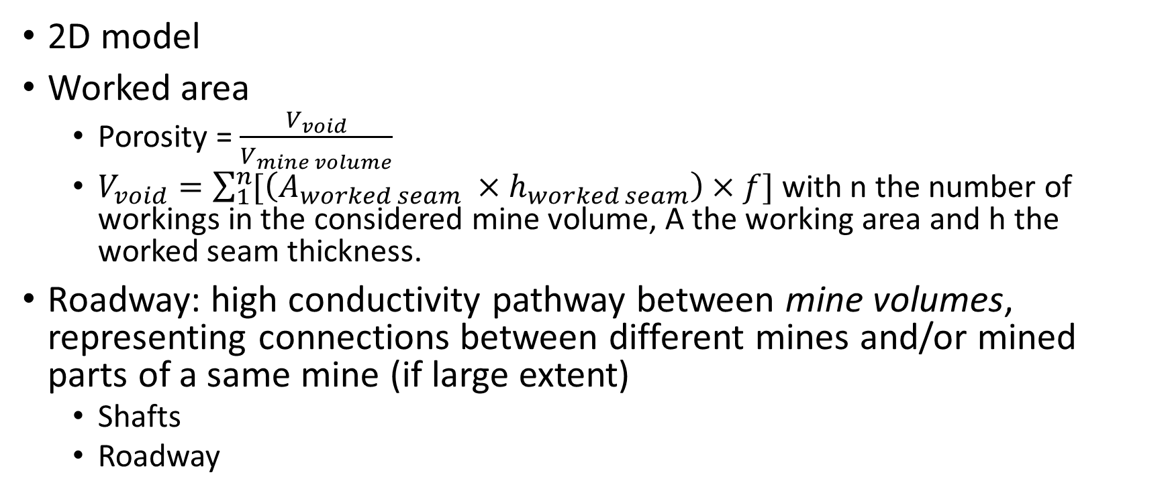
Thermal model – Model set up
2D model
Worked area
Porosity = $\frac{V_{void}}{V_{mine volume}}$
$V_{void}=\sum_{1}^{n}{[\left(A_{worked seam} ×h_{worked seam}\right)}×f]$ with n the number of workings in the considered mine volume, A the working area and h the worked seam thickness.
Roadway: high conductivity pathway between mine volumes, representing connections between different mines and/or mined parts of a same mine (if large extent)
Shafts
Roadway

Slide 7
Thermal model – Model set up
Required data
Underground working shapefile:
Area
Seam thickness
Depth min / depth max
Dip
Type (total / partial extraction)
Colliery name
Roadway
Mine entries (shafts, staple shafts, adits)
Identify monitoring points and data available at those points (total time period and data type)
Identify all connections between surface discharges and underground workings

Slide 8
Model set up
Merge corresponding working polygon
Extract points around shpefiles (X, Y)
Calculate depth at each points using dip
Import in gmsh
Calculate initial void volume at each point (sum of working layers vertically)
Calculate expected amount of subsidence
Determine residual void volume
Statistical distribution with depth
Output main workings
Connect each roadway to production/injection well
Determine initial and BC
Calibrate model with flooding TS / temperature prod and/or discharge flow rate

Slide 9
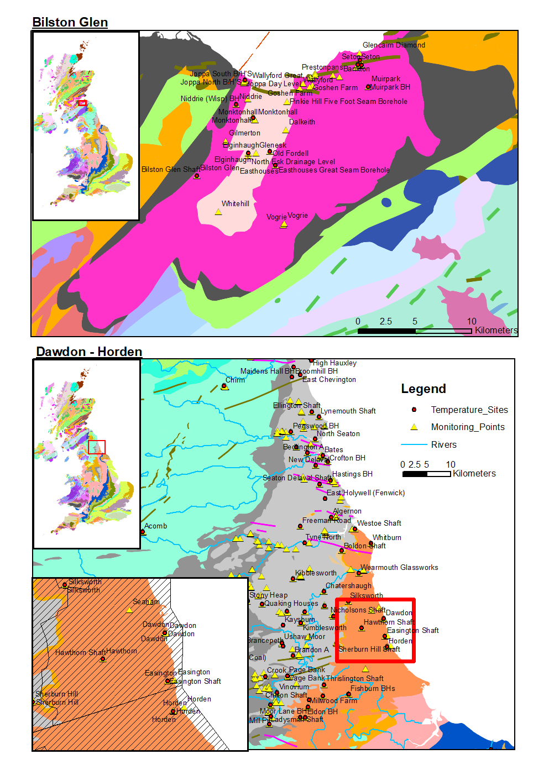

Slide 10
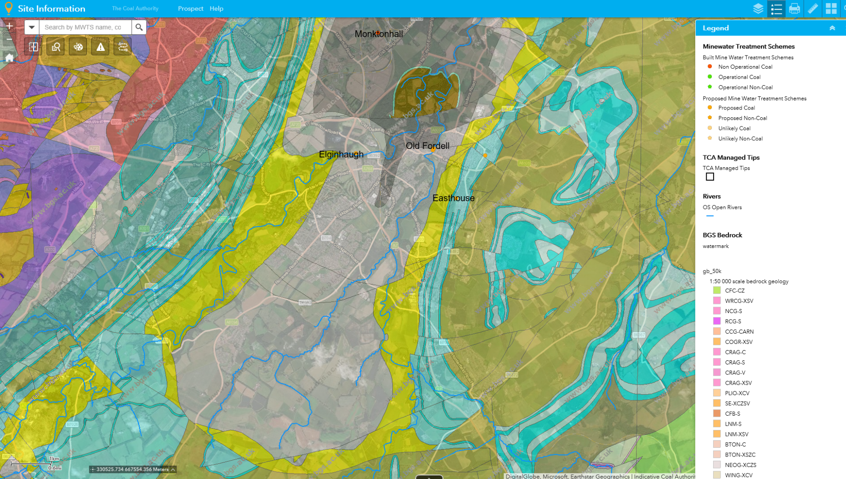

Slide 11
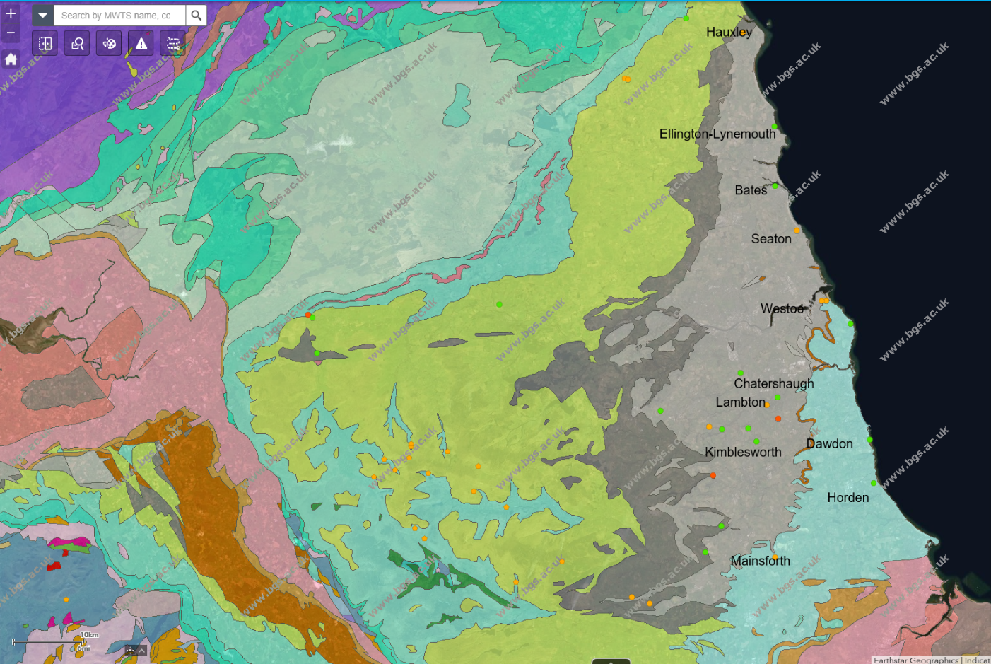

Slide 12
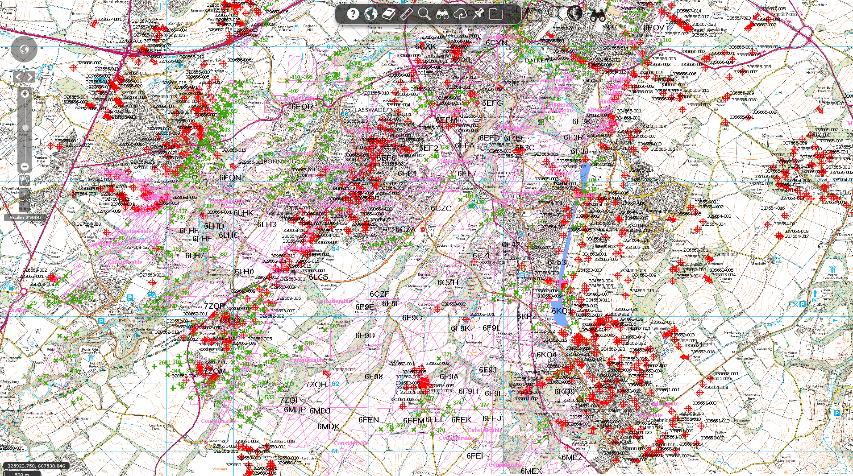

Slide 13
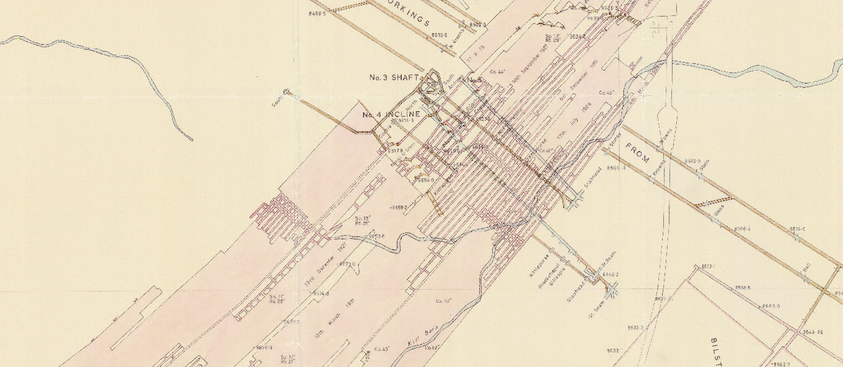

Slide 14
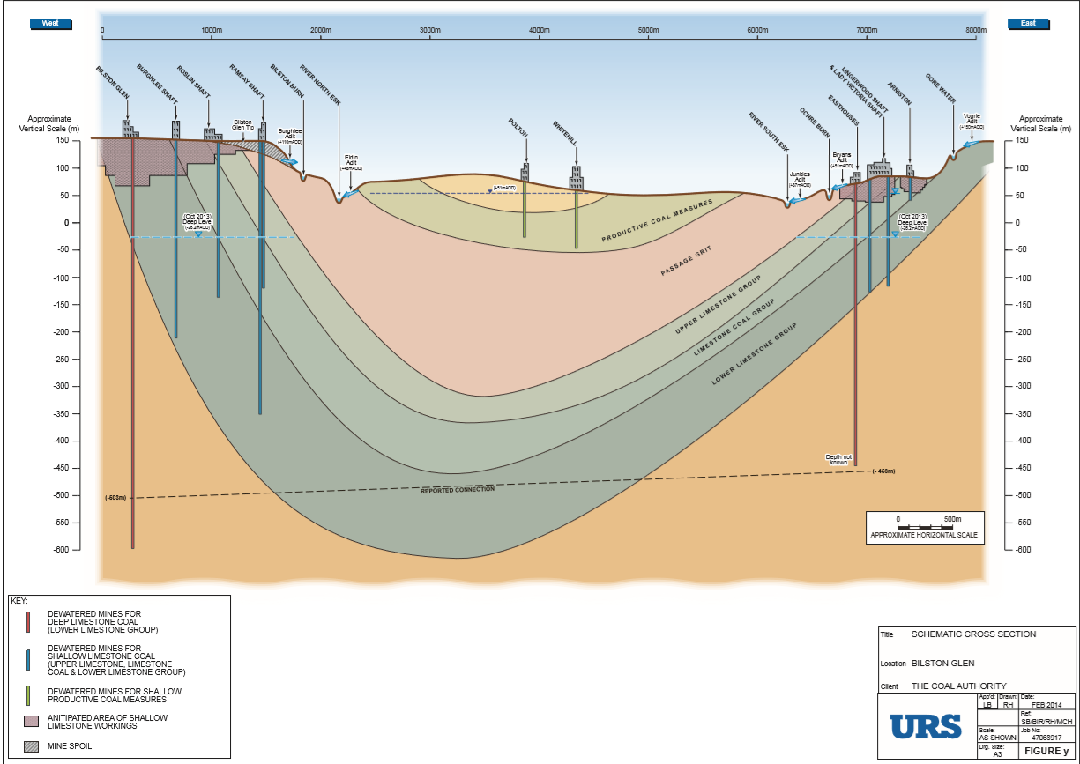

Slide 15
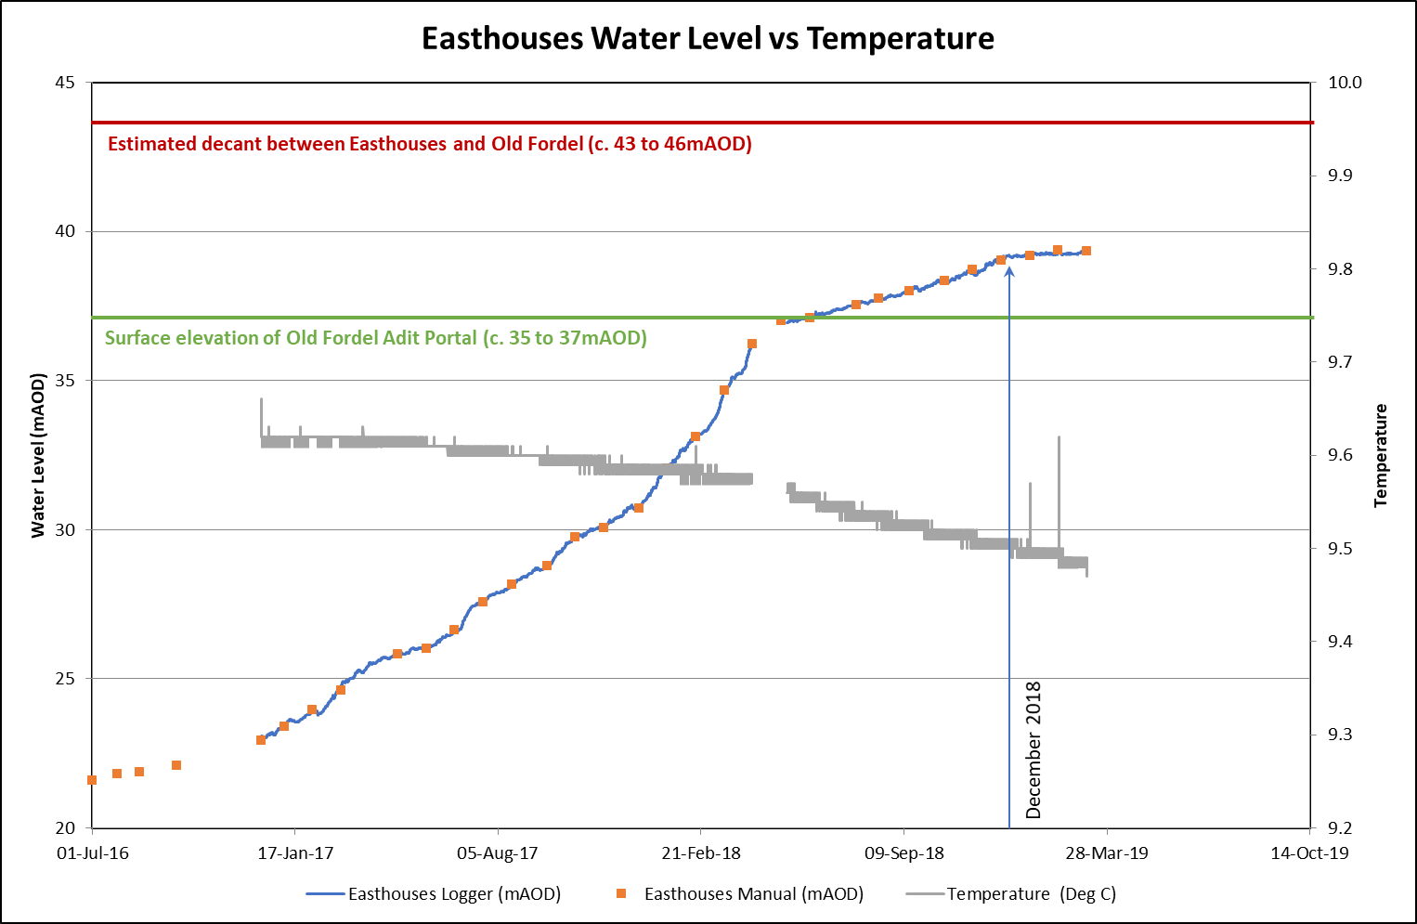

Slide 16
Bilston Glen shaft
Victoria and
Dicken’s shafts
Junkie’s
Bryan’s
Easthouse
incline/shaft
Discharge zones
Emily’s shaft
Roslin
Shallow workings (Whithill, Polton, Glenesk, Eldindean, Dalhousie, Alkaiden…)
Ramsay
?
Burghlee
?
Newbattle
Bilston Glen
?
Newton Grange
Arniston
Lingerwood/Easthouse
Lady Victoria/
Lingerwood

Slide 17
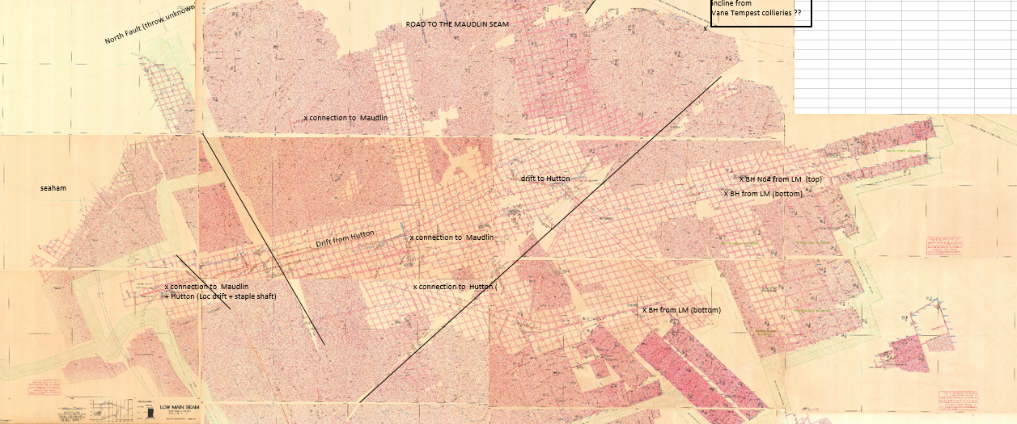
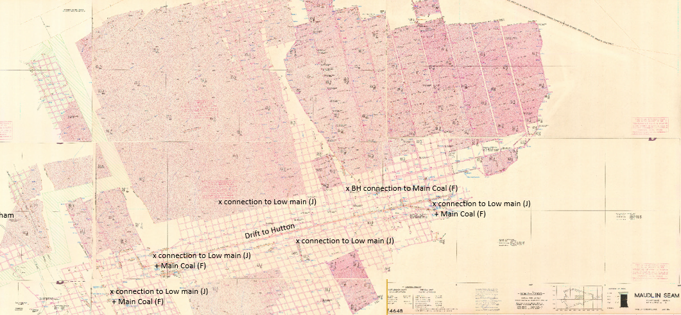

Slide 18
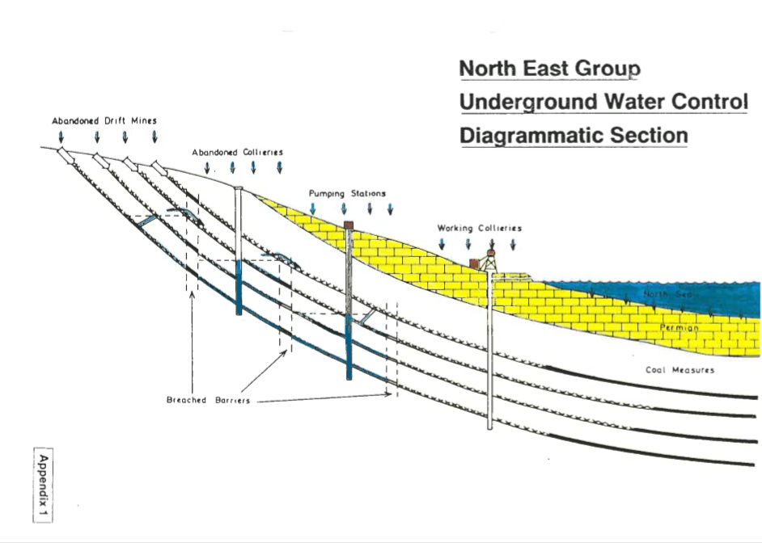

Slide 19
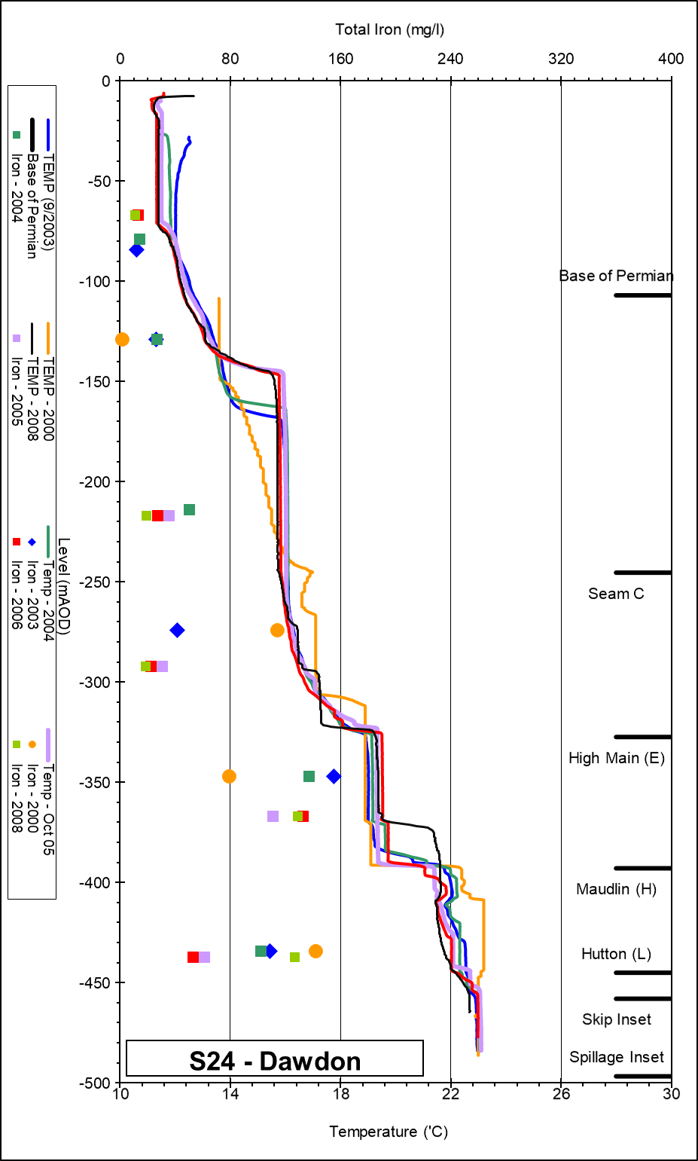

Slide 20
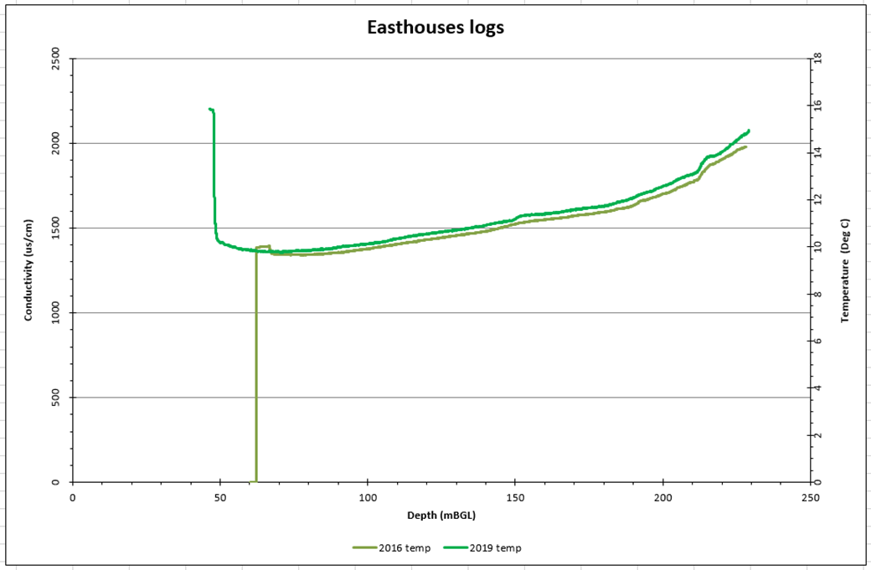
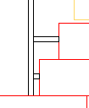
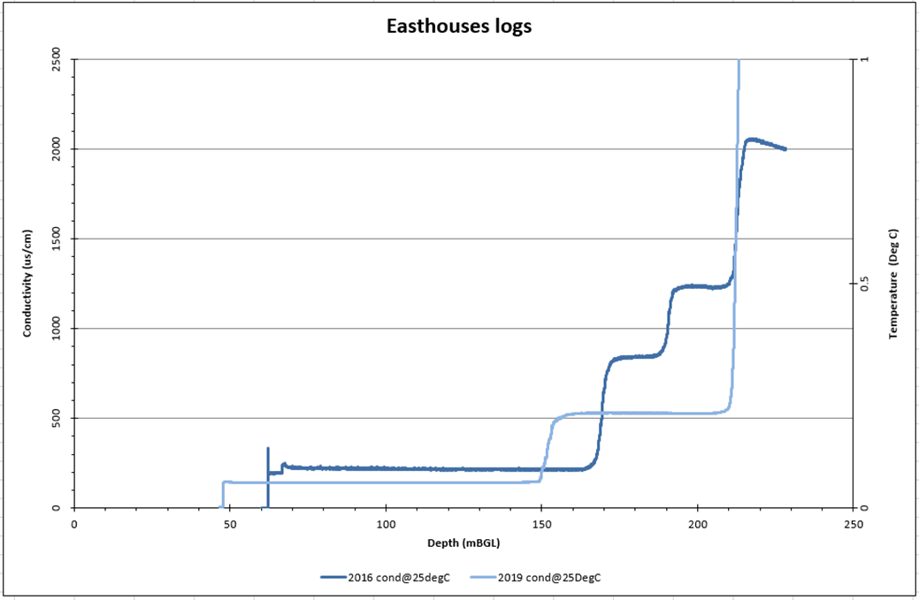
Thermal model – Model calibration
2D models natural state (no pumping)
i.e. Bilston Glen / Easthouse
Initial condition:
Initial head at the end of mining
Estimated temperature gradient from literature
Simulation of flooding (based on water level time series)
Boundary conditions :
Thermal: constant surface/bottom temperature
Water recharge: rainfall (+marine, aquifers, lateral mines)
Output
Time series of water level / temperature
Vertical profile in shafts / borehole of:
Temperature
Salinity (related to EC)
Compare simulated time-series and profiles with:
Existing time series from discharge/monitoring points (i.e. shafts)
EC-T logs in shafts/boreholes

Slide 21
Thermal model – Model calibration
2D models natural state (no pumping)
i.e. Bilston Glen / Easthouses
Initial condition:
Initial head at the end of mining
Estimated temperature gradient from literature
Simulation of flooding (based on water level time series)
Boundary conditions :
Thermal: constant surface/bottom temperature
Water recharge: rainfall (+marine, aquifers, lateral mines)
Output
Time series of water level / temperature
Vertical profile in shafts / borehole of:
Temperature
Salinity (related to EC)
Compare simulated time-series and profiles with:
Existing time series from discharge/monitoring points (i.e. shafts)
EC-T logs in shafts/boreholes

Slide 22
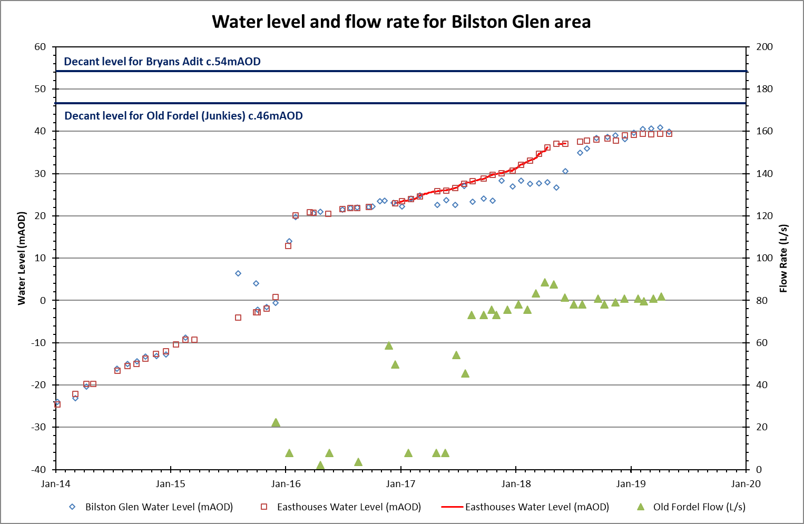
Thermal model – Model calibration
Data source:

Slide 23
Thermal model – Model validation
Data covering PhD lifetime

